Slide 1
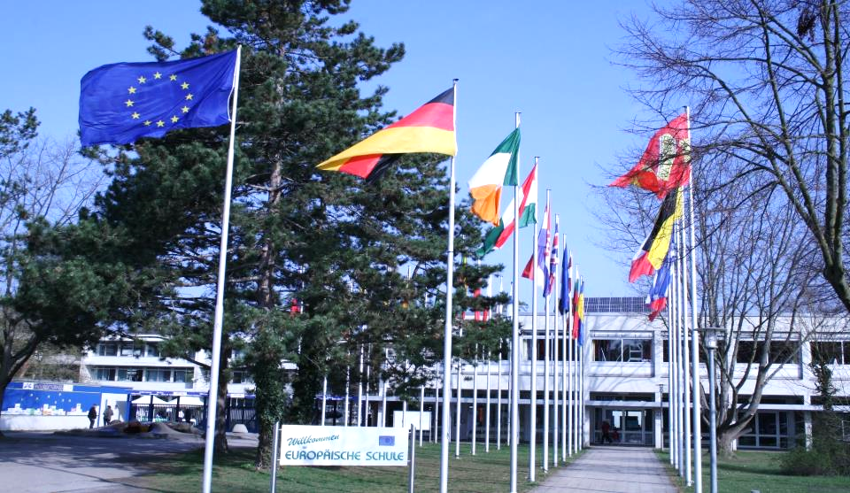
EUROPÄISCHE SCHULE KARLSRUHE ECOLE EUROPEENNE DE KARLSRUHE EUROPEAN SCHOOL KARLSRUHE VIDEO 1

Slide 2
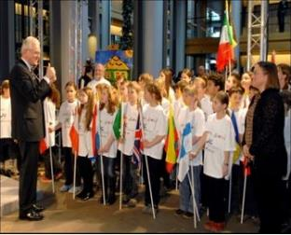
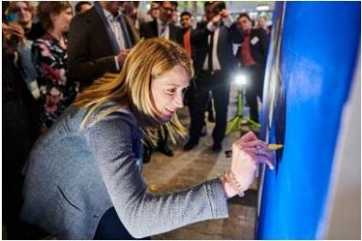
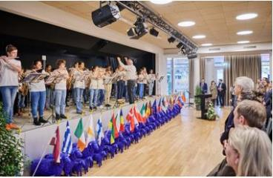
Organisation of the evening
Presentations of the School
László MUNKÁCSY
Holger KLOSE
Anabela SANTOS
Corina MAYER, Momi/Nami
Parents’ Association: Ms MARTENS, Ms THOMPSON-RENZ
Stefania BARTHOLDY

Slide 3
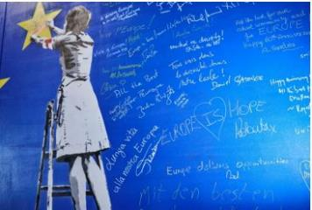
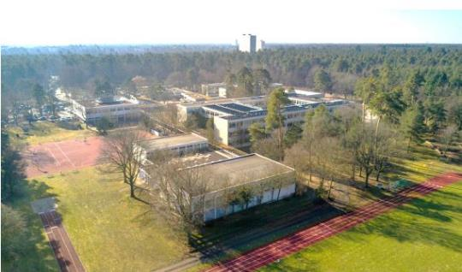
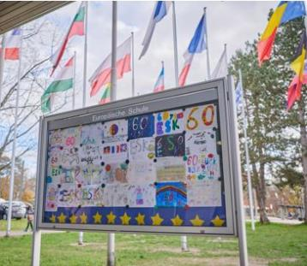
The European School System
The first school was established in 1953.
There are a total of 13 European Schools (ES) (Brussels 1,2,3,4, Mol, Luxembourg 1&2, Alicante, Bergen, Frankfurt, Munich, Varese and Karlsruhe)
and 25 Accredited European Schools (AES).
ES Karlsruhe (ESK) : in Karlsruhe since 1962

Slide 4
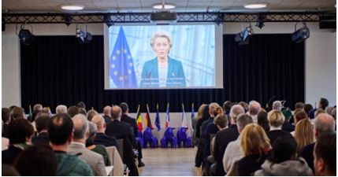
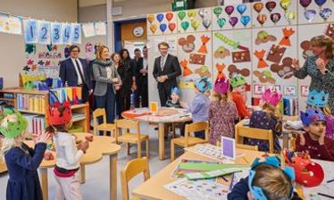
Key Features of the European Schools
Three language sections at the ESK (German, English and French)
From Nursery through Primary to Secondary culminating in graduation
with the European Baccalaureate, internationally recognised and allowing worldwide opportunities to study
Multilingual education in all EU languages - as mother tongue, with qualified native speaker teachers
High-quality in teaching and learning, with special focus on well-being, teamwork, digital skills, creativity and critical self-reflection.

Slide 5
A common school vision in teaching and learning, from the KG to the EB:
1.
To assert the European and international dimension of the school
---------
To offer high standards in mother tongue and in foreign languages
To develop strong partnerships with other schools in each language section
To develop pupils’ exchanges
To strengthen cooperation across languages sections
2.
To be an innovative school
---------
To foster project oriented learning and teaching
To develop digital competences and projects
To support new ideas and projects
To cater for sustainability and active citizenship
3.
To foster pupils’ autonomy and sense of responsibility in learning
---------
To develop social skills
To enable each pupil to become an active learner
To develop teamwork
To prepare our pupils for the next stage of education

Slide 6
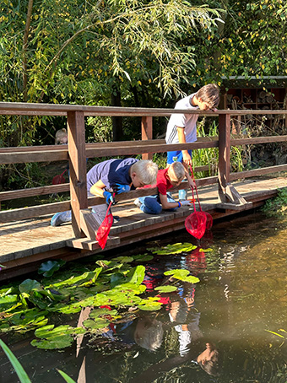
Nursery and Primary Cycle (ESK)
What is so SPECIAL about ESK?
A green 10ha campus - attractive playground
Own garden and biotop
Fresh canteen meals
After-school care
ESK buses & Trams

Slide 7
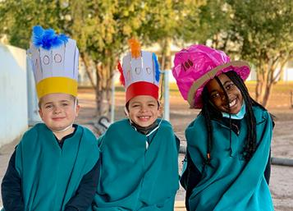
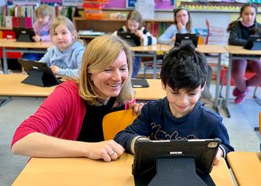
Nursery and Primary Cycle (ESK)
What is so SPECIAL about ESK?
Multilingual Setting Start of second language (L2) in class 1
The children develop a natural acceptance of cultural differences
Easy language learning on the playground
Excellent Teaching and Learning environnement
- Smartboards / iPads
- Excellent learning support

Slide 8
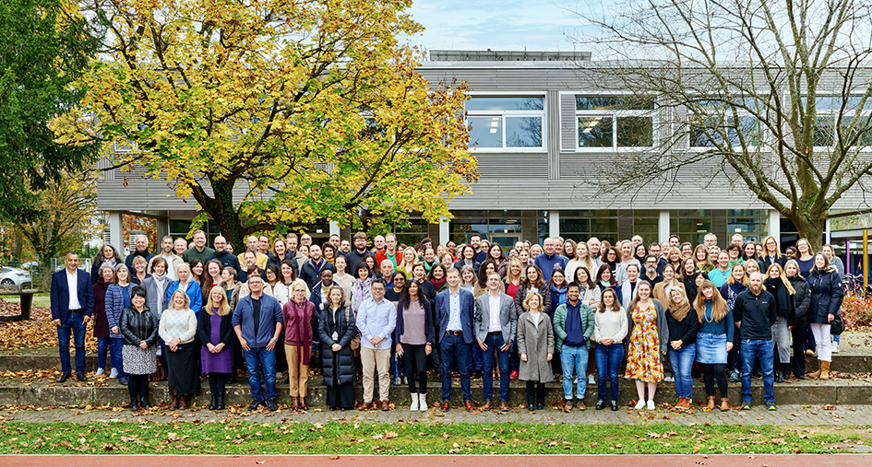
Nursery and Primary Cycle (ESK)
What is so SPECIAL about ESK?
Our whole ESK TEAM takes care of the children
Highly qualified teaching staff
Nurse
Librarian
School Psychologist
Security Staff
Care Team
Support Coordinator

Slide 9
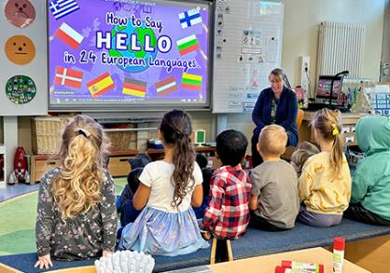
Nursery - Kindergarten
What is so SPECIAL about ESK?
2 years of Kindergarten
Children learn through a play based curriculum
Activities also in mixed groups across language sections
Transition programme from Kindergarten to Class 1 in Primary
Educational Support programme

Slide 10
SUBJECTS PRIMARY SCHOOL
1-2 Class 3-4-5 Class
Language I (mother tongue) 8h 6h30
Language II (first language) 2h30 3h45
Mathematics 4h 5h15
Discovery of the World 1h30 3h
Art, Music + Sport 5h 3h
Religion / Ethics 1h 1h30
“European hours” (From Class 3) 1h30

Slide 11
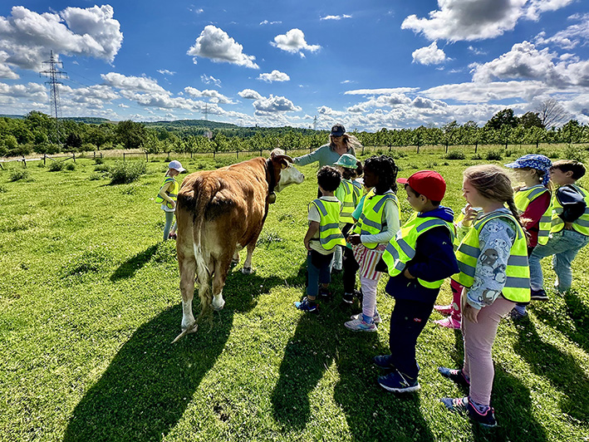
PROJECTS PRIMARY SCHOOL
Laboratory projects
Bicycle training on school premises
European Hours: Newspaper, Film making...
Project weeks
Green Week: Class trips (Primary 1-5)

Slide 12
OBERSCHULE (Gymnasium)
SECONDARY CYCLE
CYCLE SECONDAIRE
Secondary 1-3 (6.-8. Klasse)
(Observation cycle)
L1 (Dominant Language),
L2 (1st Foreign Language), L3 (2nd FL)
Mathematics, Integrated Sciences, Human Sciences, Physical Education, Rel./Ethics, Art, Music, ICT
Latin, ICT*
Secondary 4-5 (9.-10. Klasse - Pre-orientation cycle)
L1, L2, L3, Mathematics, Biology, Chemistry, Physics, Geography, History, Physical Education, Rel./Ethics,
L4 (3rd FL), Economics, Latin, Ancient Greek, Art, Music, ICT
Core subjects Optional subjects
Secondary 6-7 (11.- 12. Klasse - Orientation cycle)
L1, L2, Mathematics, Biology*, Geography**, History**, Philosophy**, Physical Education, Religion/Ethics
L3, L4, Chemistry, Physics, Economics, Advanced L1 & L2, Advanced Mathematics, Latin, Art, Laboratory Biology-Chemistry-Physics, Music, ICT, L5, Sociology

Slide 13
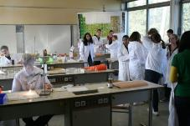
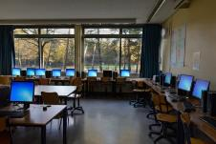
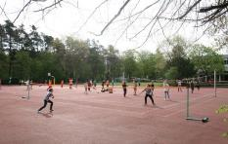
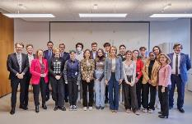
High quality of teaching
Qualified teachers, selected and evaluated in collaboration with national authorities/inspectors
Mother tongue teachers for languages
Up to date equipped teaching rooms : science labs, IT, sports halls, music, art
Differentiated teaching and provision of educational support based on individual needs
Continuous oral and written assessment of pupils
Educational advisers to support pedagogical development of the pupils

Slide 14
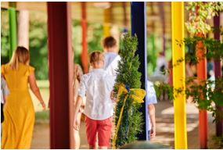
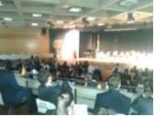
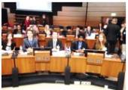
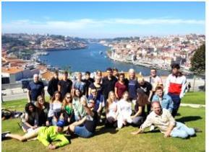
Projects to complement teaching and
strengthen pupils competences
Eurosport
Model European Council (MEC)
Philo days
European School Science Symposium
Fames
RADON Project with JRC
Challenge programme
BYOD (bring your own device)
Pro Familia programme
Pupils’ exchange programmes
School trips and excursions

Slide 15
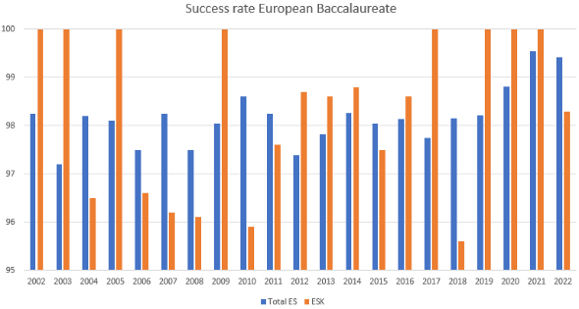
European Baccalaureate
Flexible choice of subjects corresponding to pupil’s interests
abilities
competences
High passing rates:
Fully recognized in all the countries of the European Union, as well as in a number of others e.g. Switzerland, USA, Canada. European Baccalaureate certificate holders enjoy the same rights and benefits as other holders of secondary school-leaving certificates in their countries

Slide 16
ELTERNVEREINIGUNG DER ESK
WILLKOMMEN IN DER ESK SCHULFAMILIE
https://www.esk-eltern.de
1

Slide 17
ELTERNVEREINIGUNG DER ESK
Ein gemeinnütziger Verein, in dem alle Familien an der Europäischen Schule Karlsruhe freiwillig Mitglied werden können (Beitrag 40 € pro Jahr/Familie)
Die Mitglieder tragen mit ihrem Mitgliedsbeitrag zur Projektfinanzierung bei und erhalten Zugang zu außerschulischen Aktivitäten und Ferienlagern.
Für weitere Informationen wenden Sie sich bitte an: kar-ev@partner.eursc.eu
Wer wir sind:
Unser Ziel:
Eltern und Schüler*innen durch die Arbeit als Bindeglied zwischen Familien und der Schule zu unterstützen
https://www.esk-eltern.de
2

Slide 18
WANN SIE UNS SEHEN...
VERANSTALTUNGEN:
PA CAFÉ - PA SOCIAL
PA SOMMERFEST
EUROBOUTIQUE
KANTINEN AUSSCHUSS
AUSSERSCHULISCHE AKTIVITÄTEN
FERIEN CAMPS
TRANSPORT AUSSCHUSS
SCHULFOTOS
https://www.esk-eltern.de
3

Slide 19
.. HINTER DEN KULISSEN
Was wir sonst noch tun:
Sozialfonds
Halbjährlich stattfindende Verwaltungsausschüsse
Arbeitsgruppen: Stundenplanstruktur
Arbeitsgruppe: Sicherheit und Gesundheit
Arbeitsgruppe: Nachhaltigkeit
Arbeitsgruppe: PISA-Überprüfung
BAC-Aufsicht
Internationales Café: Tag der offenen Tür und Einschulung
Elternvertreter-Treffen und Beratung
SEN-Beratung für Eltern
Halbjährlich Bildungsräte: Grundschule und Oberschule
Beteiligung an INTERPARENTS
Buchpreise für akademische Leistungen der OS- Schüler*innen
https://www.esk-eltern.de
7

Slide 20
WUSSTEN SIE SCHON?
Wichtige Fakten
Der EV-Ausschuss (PAC) hat 17 Mitglieder und 10 (??) Beobachter, die jeden Tag mithelfen.
Alle PAC-Mitglieder sind ehrenamtlich und arbeiten unentgeltlich.
Das PAC ist immer auf der Suche nach neuen Helfern, die helfen und die Schule verbessern wollen.
Ihr Beitrag ist wirklich wichtig; schon die Teilnahme an den Veranstaltungen der EV kann einen Unterschied machen. Zum Beispiel verkauft die EV während des Sommerfestes Kuchen, und wenn Sie auch nur ein Stück davon kaufen, leisten Sie einen Beitrag und spenden Geld für die Schulprojekte des nächsten Jahres.
Ein Mitglied der EV zu sein bedeutet
Teil der Gemeinschaft zu sein und sich an EV-Projekten zu beteiligen
zur Finanzierung von Projekten beizutragen und diese aufzustocken
Einblicke in das Bildungssystem zu gewinnen
Neue Netzwerke zu schaffen und neue Beziehungen aufzubauen
VERPASSEN SIE NICHT DIE GELEGENHEIT, UNSERE SCHULE ZU UNTERSTÜTZEN, WERDEN SIE MITGLIED DER EV: HTTPS://WWW.ESK-ELTERN.DE/DE/REGISTRATION/
8

Slide 21
TOGETHER WE ARE STRONGER
TOGETHER WE ARE ESK
https://www.esk-eltern.de
9

Slide 22
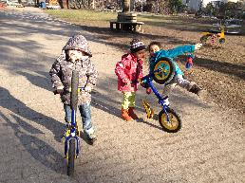
After school care at the European School Karlsruhe organized by MoMi/Nami (club/Verein) MoMi: Mondays, Wednesdays + Fridays 12:15 – 15:35 (Tuesdays and Thursdays are long days at school until 15:35) Lunch together at the lunchroom, free time in the playground, homework supervision from 1st to 5thgrade (G/E/F), arts and crafts and games. NaMi: Monday to Friday 15:35-18:00 Healthy snack, play time outside of kindergarden, arts and crafts and games in the classrooms of the Primary School building.
Nachmittagsbetreuung an der Europäischen Schule Karlsruhe e.V.
„MoMi“ KG and GS
Albert Schweitzer Sraße 1, 76139 Karlsruhe
info@momi-nachmittagsbetreuung.eu

Slide 23
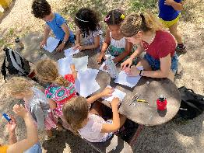
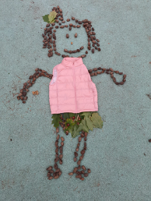
The supervision times
 | MoMi | NaMi
Monday | 12.15-3.35 pm | 3.35-6.00 pm
Tuesday |  | 3.35-6.00 pm
Wednesday | 12.15-3.35 pm | 3.35-6.00 pm
Thursday |  | 3.35-6.00 pm
Friday | 12.15-3.35 pm | 3.35-5.00 pm 5.00-6.00 pm
Costs
The participation in the after-school child care program is voluntary but liable for payment. In advance, you have to choose the days on which your child participates either per semester or for the full school year.
MoMi
After-school care til end of school day (3.35 pm)
 |  | sem | fy
Monday | 12.15-3.35 pm | 280 € | 500 €
Tuesday
Wednesday | 12.15-3.35 pm | 280 € | 500 €
Thursday
Friday | 12.15-3.35 pm | 280 € | 500 €
NaMi
After-school care after the end of a school day
(3.35 – 6.00 pm bzw. 5 pm)
 |  | sem | fy
Montag | 3.35-6.00 pm | 165 € | 280 €
Dienstag | 3.35-6.00 pm | 165 € | 280 €
Mittwoch | 3.35-6.00 pm | 165 € | 280 €
Donnerstag | 3.35-6.00 pm | 165 € | 280 €
Freitag | 3.35-5.00 pm 5.00-6.00 pm | 100 € 65 € | 170 € 110 €
1. semester (sem) : September-January
2. semester (sem) : February-July
Full year (fy) : September-July

Slide 24
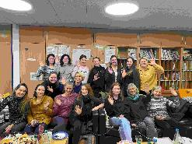
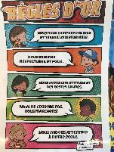
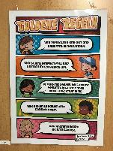
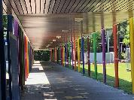
We collaborate with: ESK - Headmaster (Open-door day, Summer festival, etc.) - Primary School headmaster (the MoMi/NaMi Teachers take place in the Primary School building – the rules of the ESK apply) - secretary, school-nurse, caretaker building - Teachers, Preschool teachers from KG and Primary School (Handing over the pupils after classes are finished) Parents Association (PA) The kids will be accompanied to the activities organized by the PA (within the school area) We are pleased if you are interested in our care program. Please feel free to contact us: www.momi-nachmittagsbetreuung.eu email: info@momi-nachmittagsbetreuung.eu Contact: Corina Mayer
Nachmittagsbetreuung an der Europäischen Schule Karlsruhe e.V.
„MoMi“ KG and GS
Albert Schweitzer Sraße 1, 76139 Karlsruhe
info@momi-nachmittagsbetreuung.eu

Slide 26
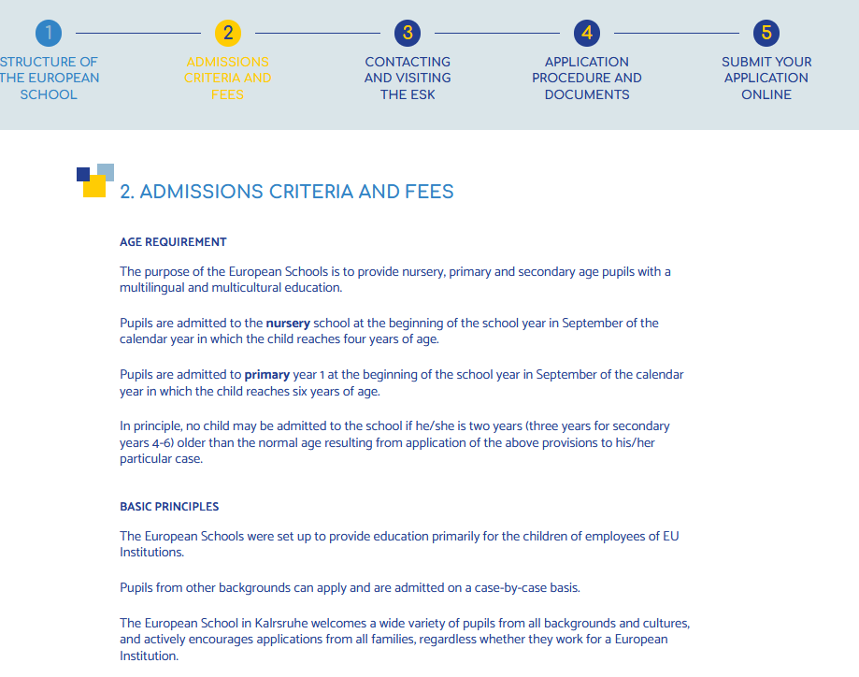

Slide 27
Breakdown of pupils into three categories
Admissions will take place in accordance with the decisions of the Board of Governors and applications will be processed in the following order of priority:
Category I: Eligible pupils - Children of staff in the service of the Community institutions
Category II: Pupils covered by individual agreements or by multinational corporations and other companies that have signed special agreements , each entailing specific rights and obligations for the pupils concerned, particularly as regards school fees. Private families can also sign an individual financial agreement - Cat.II
Category III: These pupils would be admitted to the European Schools in so far as places are available. The decision will be taken at last, following the order of priority of admission, after all children in Categories I and II have been enrolled.
Special consideration is given to siblings
Concerning admission criteria and school fees, please see more details here:
www.eursc.eu https://www.eursc.eu/en/European-Schools/enrolments/admission

Slide 28
School fees do not include
meal, transportation costs, school trip, books, after school care, extra-curricular activities etc.
The price lists for additional services are published on the school website

Slide 29
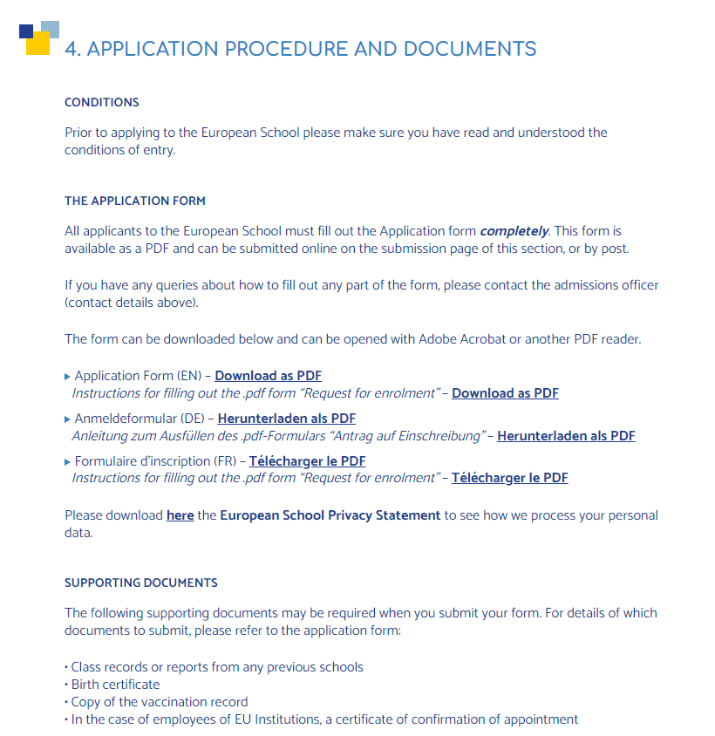

Slide 30
Enrolment
For more information about the European School Karlsruhe and application process, please feel free to contact us.
We look forward to introducing you to our school and its special features and answering any questions you may have.
Stefania Bartholdy
Admission Officer
TEL +49 (0) 721 68009-72
info@es-karlsruhe.eu

Slide 31
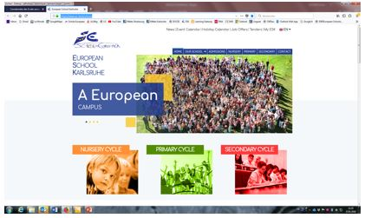
Thank you for your attention !
8 March : Open Day at the ESK
Europäische Schule Karlsruhe
Albert Schweitzer Str. 1
D-76139 Karlsruhe
Tel: 0049 (0)7 21 6 80 09-0
www.es-karlsruhe.eu

